Slide 1
What is Selenium?
Selenium is a free (open-source) automated testing framework used to validate web applications across different browsers and platforms. You can use multiple programming languages like Java, C#, Python etc to create Selenium Test Scripts. Testing done using the Selenium testing tool is usually referred to as Selenium Testing.

Slide 2
Selenium Software is not just a single tool but a suite of software, each piece catering to different Selenium QA testing needs of an organization. Here is the list of tools-
Selenium Integrated Development Environment (IDE)
Selenium Remote Control (RC)
WebDriver
Selenium Grid

Slide 3
Who developed Selenium?
Since Selenium is a collection of different tools, it had different developers as well. Primarily, Selenium was created by Jason Huggins in 2004. An engineer at ThoughtWorks, he was working on a web application that required frequent testing. Having realized that the repetitious Manual Testing of their application was becoming more and more inefficient, he created a JavaScript program that would automatically control the browser's actions. He named this program as the "JavaScriptTestRunner."

Slide 4
Birth of Selenium Remote Control (Selenium RC)
Another ThoughtWork's engineer, Paul Hammant, decided to create a server that will act as an HTTP proxy to "trick" the browser into believing that Selenium Core and the web application being tested come from the same domain. This system became known as the Selenium Remote Control or Selenium 1.

Slide 5
Birth of Selenium Grid
Selenium Grid was developed by Patrick Lightbody to address the need of minimizing test execution times as much as possible.

Slide 6
Birth of Selenium IDE
Shinya Kasatani of Japan created Selenium IDE, a Firefox extension that can automate the browser through a record-and-playback feature. He came up with this idea to further increase the speed in creating test cases. He donated Selenium IDE to the Selenium Project in 2006.

Slide 7
Birth of WebDriver
Simon Stewart created WebDriver circa 2006 when browsers and web applications were becoming more powerful and more restrictive with JavaScript programs like Selenium Core. It was the first cross-platform testing framework that could control the browser from the OS level.

Slide 8
Brief Introduction Selenium IDE
Selenium Integrated Development Environment (IDE) is the simplest framework in the Selenium suite and is the easiest one to learn. It is a Firefox plugin that you can install as easily as you can with other plugins. However, because of its simplicity, Selenium IDE should only be used as a prototyping tool. If you want to create more advanced test cases, you will need to use either Selenium RC or WebDriver.

Slide 9
Brief Introduction Selenium Remote Control (Selenium RC)
Selenium RC was the flagship testing framework of the whole Selenium project for a long time. This is the first automated web testing tool that allowed users to use a programming language they prefer. As of version 2.25.0, RC can support the following programming languages:
Java
C#
PHP
Python
Perl
Ruby

Slide 10
Brief Introduction WebDriver
The WebDriver proves itself to be better than both Selenium IDE and Selenium RC in many aspects. It implements a more modern and stable approach in automating the browser's actions. WebDriver, unlike Selenium RC, does not rely on JavaScript for Selenium Automation Testing. It controls the browser by directly communicating with it.The supported languages are the same as those in Selenium RC.

Slide 11
Selenium Grid
Selenium Grid is a tool used together with Selenium RC to run parallel tests across different machines and different browsers all at the same time. Parallel execution means running multiple tests at once.
Features:
Enables simultaneous running of tests in multiple browsers and environments.
Saves time enormously.
Utilizes the hub-and-nodes concept. The hub acts as a central source of Selenium commands to each node connected to it.

Slide 12
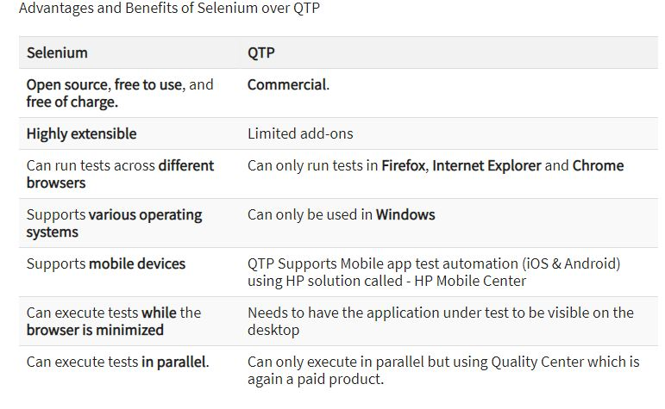

Slide 13
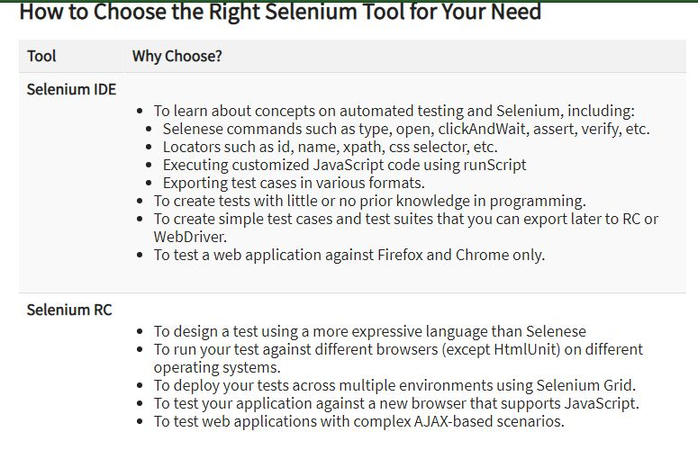

Slide 14
